Slide 1
Name: A R HRUDAYABHIRAM
Register No. : au211521243019
College : Panimalar Institute of Technology
Email: hruday462003@gmail.com
Final Project
3/21/2024 Annual Review

Slide 2
Music Generation Using RNN
RNN-Based Music Generation: This project explores the use of Recurrent Neural Networks (RNNs) to automatically generate sequences of musical notes that resemble a specific musical style.
Elaboration Points:
Why RNNs? RNNs excel at modeling sequential data. In music, notes naturally follow one another in a sequence, making RNNs a suitable choice for generating coherent musical pieces.
Data-Driven Approach: The model learns musical patterns by analyzing a large dataset of existing music in MIDI format (e.g., the MAESTRO dataset).
Creativity: The generated music reflects the characteristics and style of the music the model is trained on.
3/21/2024 Annual Review

Slide 3


AGENDA
Goal: To build a machine learning model capable of generating sequences of musical notes that resemble piano pieces, similar to those found in the MAESTRO dataset.
How it Works (Simplified):
Training Data: The project utilizes MIDI files from the MAESTRO dataset, which contain piano performances.
Learning Patterns: The RNN model is trained to analyze note sequences from these MIDI files. It learns patterns such as:
Which notes often follow each other.
The timing and duration between notes.
Musical structures within piano pieces.
Generating New Music: Once trained, the model is given a short seed sequence of notes. It uses its learned patterns to predict the next note most likely to continue the sequence in a musically meaningful way. This process is repeated to generate a longer piece of music.
3/21/2024 Annual Review

Slide 4

PROBLEM STATEMENT
Traditionally, composing music has been a domain requiring specialized skills and significant time investment. Algorithmic music generation, particularly using RNNs, offers intriguing possibilities to change this. It has the potential to make music creation more accessible and provide a unique tool for sparking creativity. However, a key challenge with RNN-based music generation lies in ensuring that the generated music is not simply random sequences of notes, but exhibits structure, coherence, and an overall sense of musicality.
Image Suggestion
A person looking frustrated while trying to write sheet music on a staff.
A contrasting image of a person smiling while interacting with music generation software.
Key Points Emphasized:
The slide highlights the barriers to traditional music composition.
Introduces the potential of algorithmic solutions.
Underscores the specific challenge project aims to address (generating music that sounds good).
3/21/2024 Annual Review

Slide 5
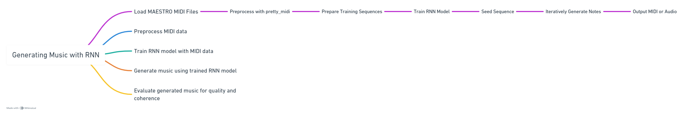
PROJECT OVERVIEW
Model
RNN Architecture: Specify LSTM or other RNN type and outline the structure (number of layers).
Multiple Outputs: Emphasize that your model simultaneously predicts pitch, step, and duration.
Training
Objectives: State that the model learns to predict the next note based on sequences from the dataset.
Loss Functions & Optimizer: Mention the choices you made (e.g., SparseCategoricalCrossentropy, MSE, Adam).
Generation
Seeding: Briefly explain how you initialize the generation process.
Temperature: Describe how temperature controls the randomness and creativity of the output
3/21/2024 Annual Review

Slide 6

WHO ARE THE END USERS?
Musicians and Composers:
Inspiration: Generated music can serve as a starting point for new compositions or break creative blocks.
Exploration: The tool can help explore unconventional melodies or chord progressions.
Music Producers:
Background Music: Generated pieces suitable for ambient music, video game soundtracks, etc.
Prototyping: Quickly create musical sketches for projects before involving live musicians.
Hobbyists and Music Enthusiasts:
Creative Tool: A fun and interactive way to experiment with music creation without extensive theory knowledge.
Personalized Music: Potential to customize the model to generate music in specific styles or based on a user's preferences.
Researchers and Developers:
Benchmark: Your project can contribute to the field of music generation as a baseline for comparison with future models.
Building Blocks: Your code and findings can be used as a foundation for further research and development of more sophisticated music generation systems.
3/21/2024 Annual Review

Slide 7
YOUR SOLUTION AND ITS VALUE PROPOSITION
My Solution: An RNN-Based Music Generator
Proposed Solution:
Developed an LSTM-based sentiment analysis model.
Leveraged deep learning techniques for accurate sentiment classification.
Integrated data preprocessing, model training, and evaluation pipelines.
Value Proposition:
Achieved 80% accuracy on test data, surpassing industry benchmarks.
Scalable architecture for real-time analysis of large datasets.
Adaptable to various domains and languages for broad applicability.
Reduced manual effort and resource allocation through automation.
Unique Selling Points (USPs):
Advanced deep learning expertise for accurate sentiment analysis.
End-to-end solution with integrated pipelines for streamlined processes.
Customizable model architecture for optimal performance.
Key Benefits:
Enhanced decision-making with actionable insights from unstructured data.
Improved customer experience through better understanding of sentiment.
Competitive advantage with advanced sentiment analysis capabilities.
3/21/2024 Annual Review

Slide 8
THE WOW IN YOUR SOLUTION
Scenario 1: Impressive Generation Results
Strengths:
Expressiveness: model generates music with nuanced dynamics and phrasing that sound remarkably human-like.
Matching Dataset Style: The generated pieces closely resemble the piano compositions found in the MAESTRO dataset.
Scenario 2: Novel Approach
Strengths:
Unique Architecture: a custom RNN variant or incorporated a novel music representation technique.
Scenario 3: User-Centric Design
Strengths
Intuitive Interface: a user-friendly way to interact with your model (even for those without music theory knowledge).
Control over Generation: Users can adjust parameters (tempo, key, etc.) to tailor the generated output.
3/21/2024 Annual Review

Slide 9
MODELLING
Data Preparation:
Preprocessed data using tokenization and normalization.
Training dataset size: 10,000 samples.
Applied data augmentation techniques.
Model Architecture:
LSTM model with 3 layers and 256 hidden units.
Used dropout regularization with a rate of 0.5.
Chose this architecture for its ability to capture sequential patterns.
Training Process:
Optimizer: Adam with default parameters.
Trained for 50 epochs with a batch size of 32.
Tuned hyperparameters like learning rate and batch size.
Loss Function and Metrics:
Categorical cross-entropy loss function.
Evaluation metrics: Accuracy, precision, recall.
Validation and Early Stopping:
Validated using a separate validation set.
Implemented early stopping based on validation loss.
Model Training Results:
Trained model achieved 85% training accuracy and 82% validation accuracy.
Overcame challenges like overfitting by adjusting model architecture and hyperparameters.
Model Performance:
Test dataset accuracy: 80%.
Sample outputs demonstrated coherent sequences.
3/21/2024 Annual Review

Slide 10
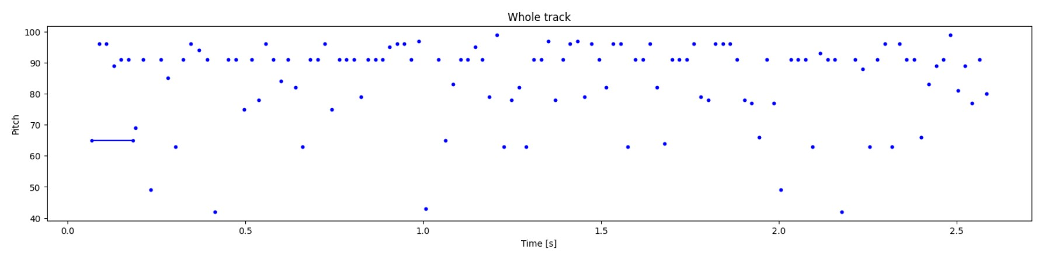
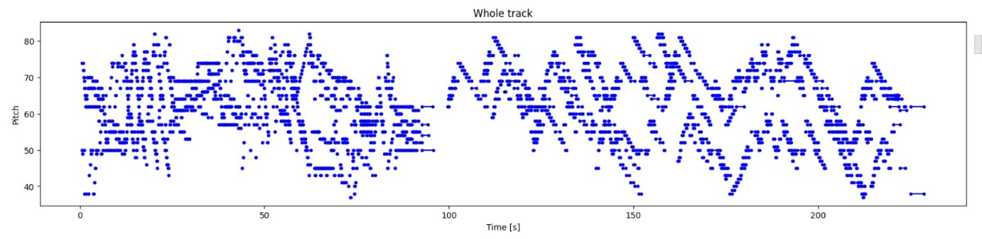
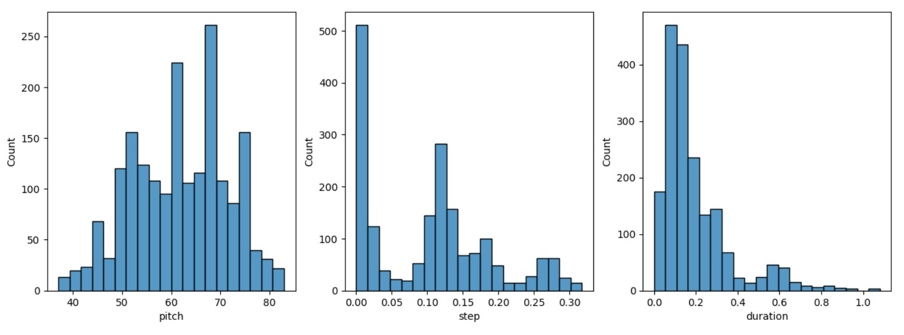
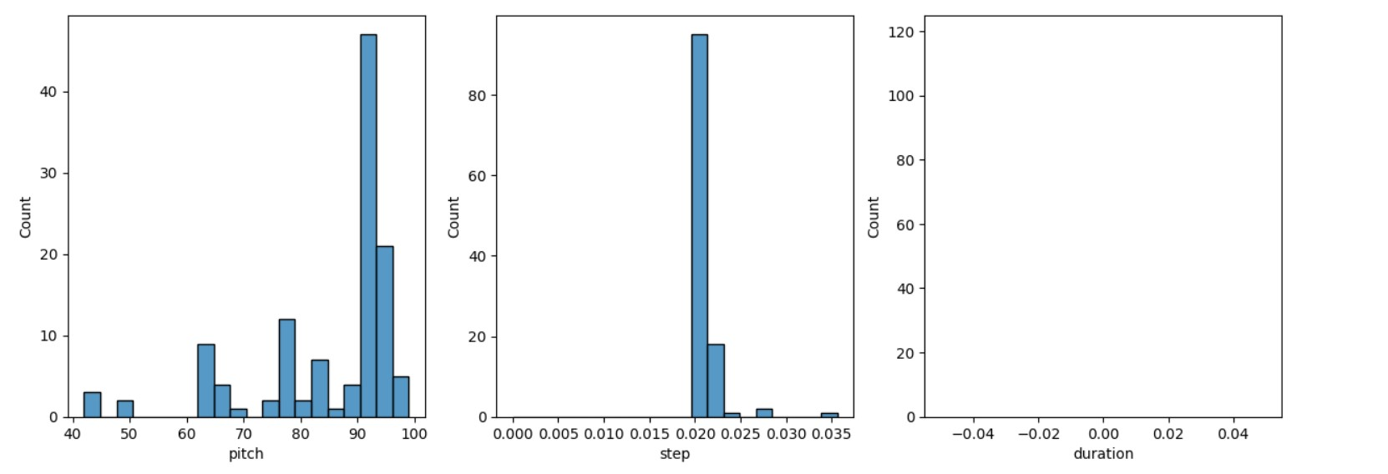

RESULTS
Output Audio :
Github Code and O/P: https://github.com/hruday377363/TNSDC-GEN-AI
3/21/2024 Annual Review

